Slide 1
Healthcare Disparities in The District of Columbia
A look through the lens of one hospital

Slide 2
DC’s Healthcare Landscape
https://public.tableau.com/profile/shant.ayanian#!/

Slide 3
Education and Poverty
https://public.tableau.com/profile/shant.ayanian#!/

Slide 4
Age and illness Average age is lower in areas with higher severity of illness
https://public.tableau.com/profile/shant.ayanian#!/

Slide 5
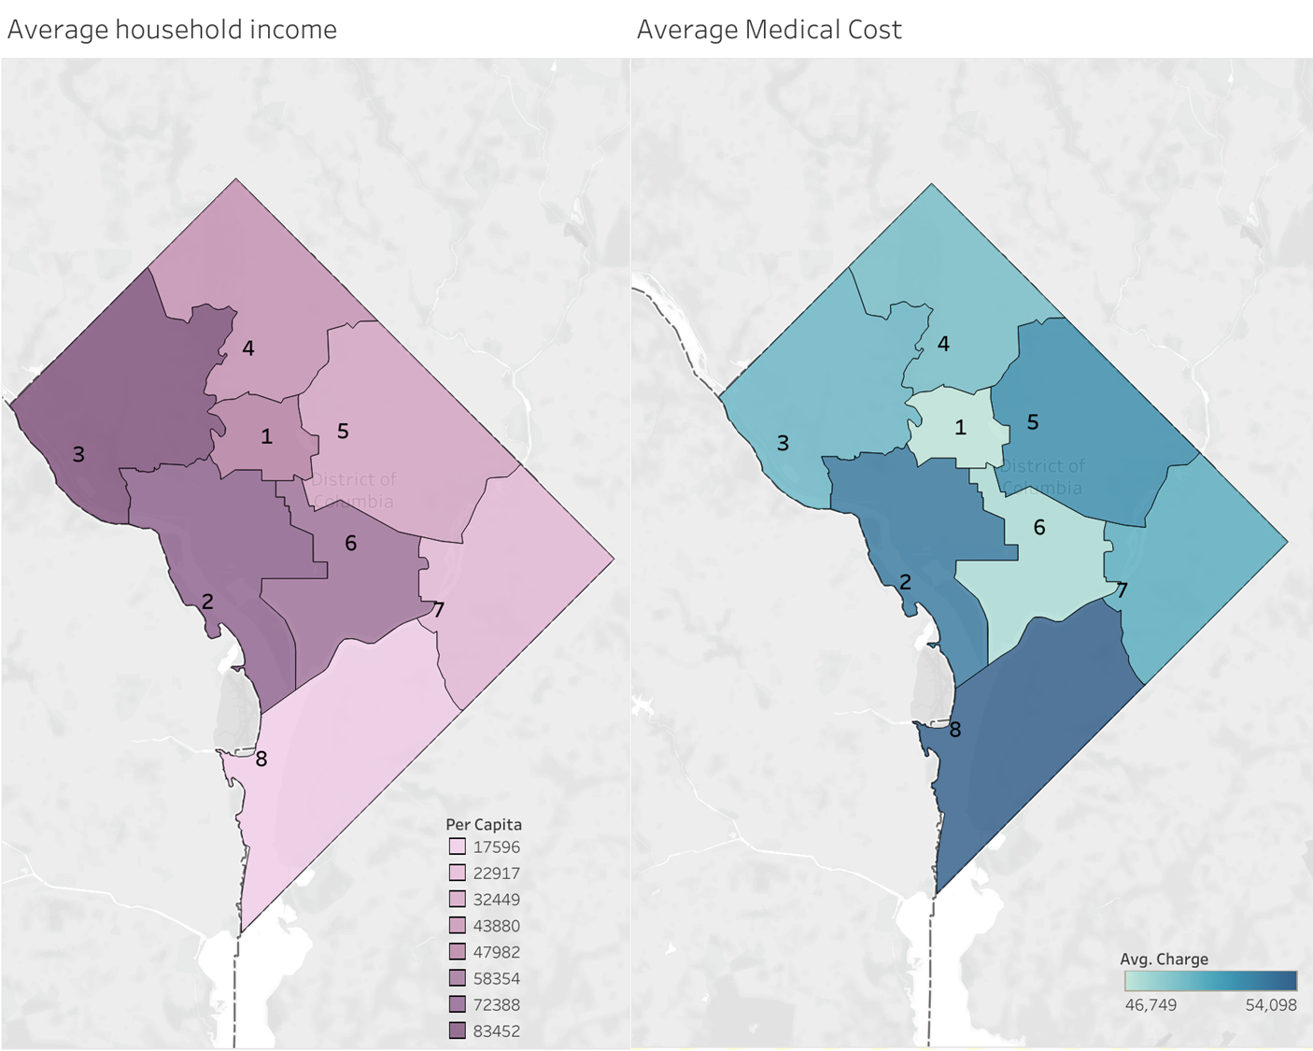
Income vs medical costs The poorer wards are paying the highest for medical care
https://public.tableau.com/profile/shant.ayanian#!/

Slide 6
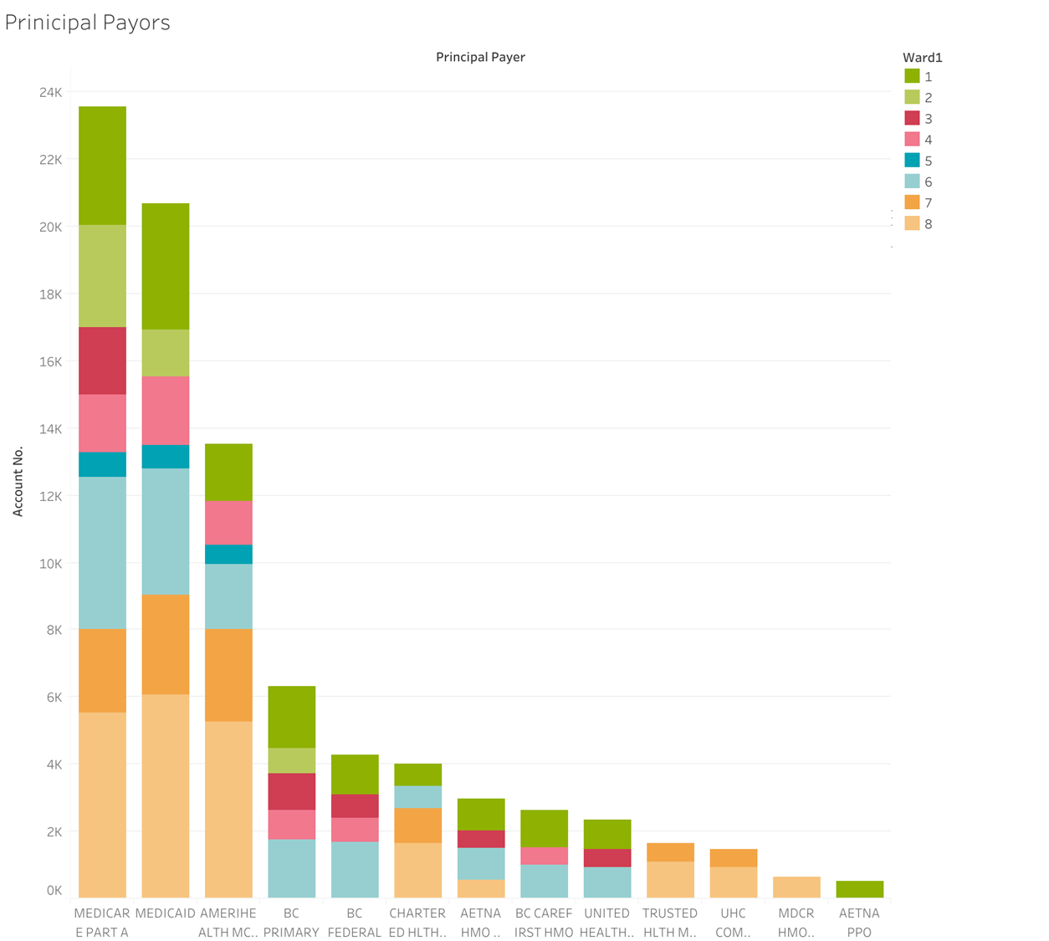
Distribution of payors tool is interactive online Medicare and Medicaid are primary payors across wards
https://public.tableau.com/profile/shant.ayanian#!/

Slide 7
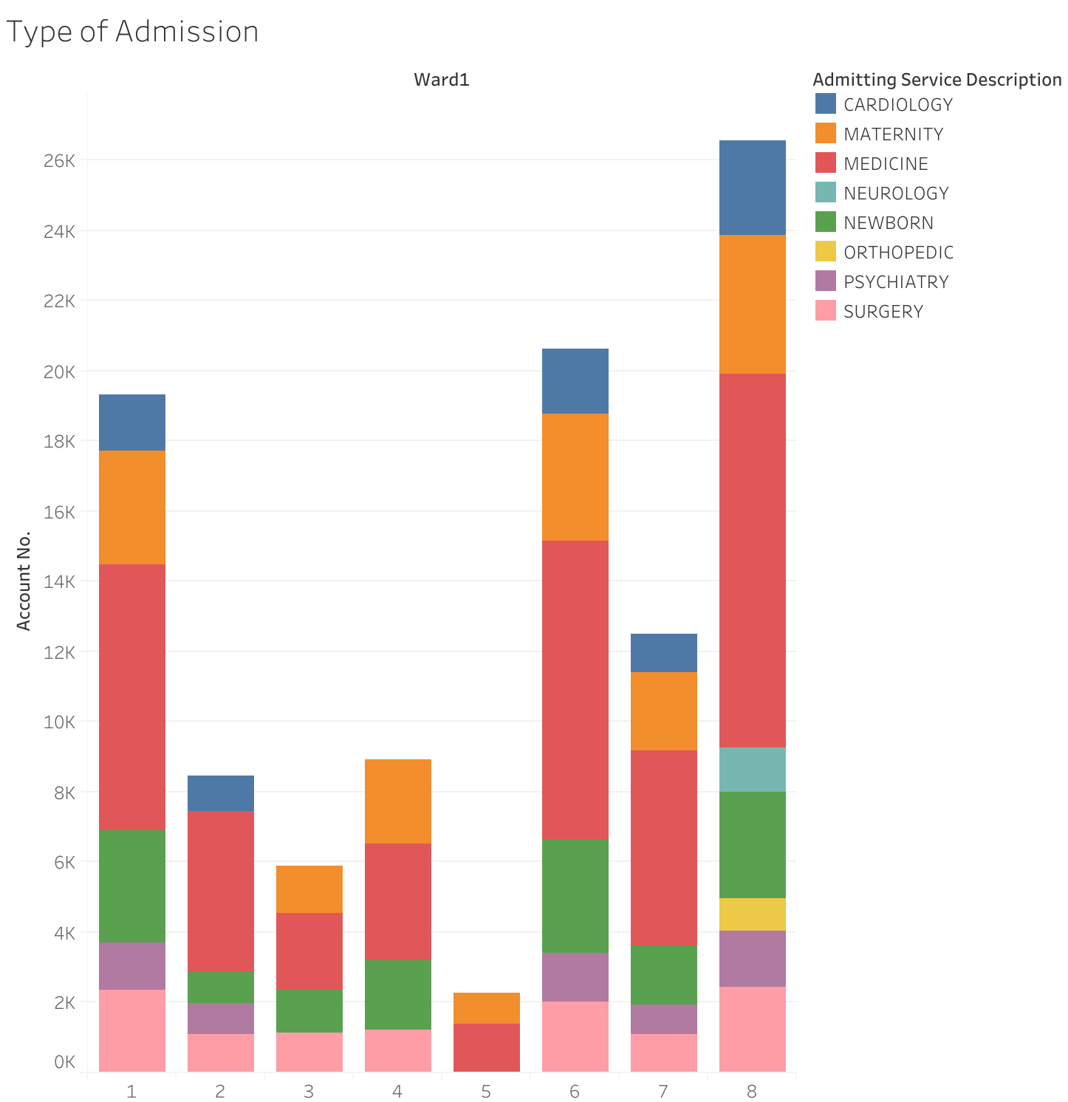
Types of admission Tool is interactive Clear predominance of medical admissions
https://public.tableau.com/profile/shant.ayanian#!/

Slide 8
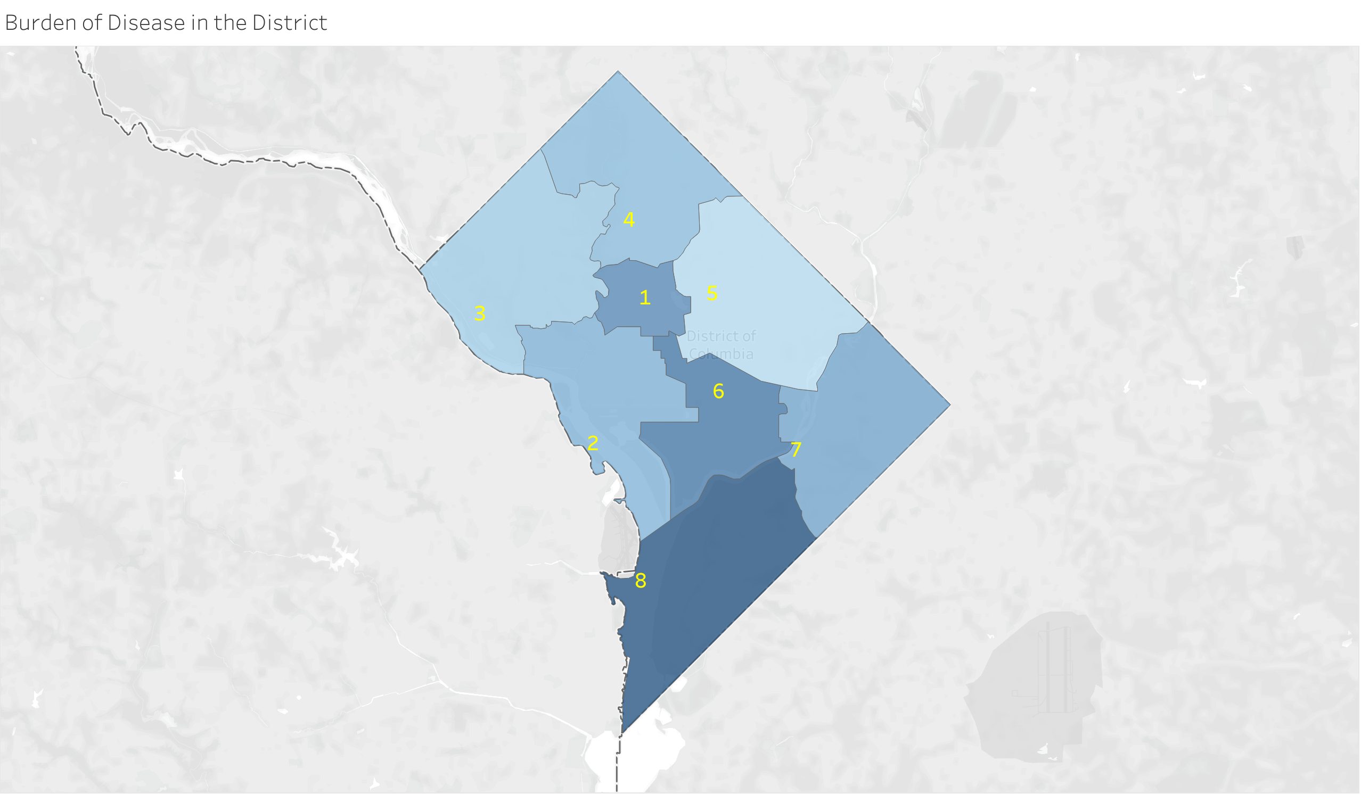
Burden of disease Interactive tool , main conlucison is burden is highest at wards 8 and 6
https://public.tableau.com/profile/shant.ayanian#!/

Slide 9
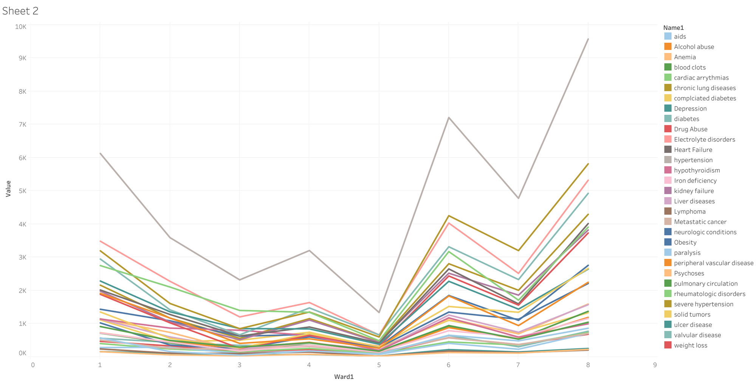
Summary of Burden of Disease Ward 5 is underrepresented in this sample
https://public.tableau.com/profile/shant.ayanian#!/

Slide 10
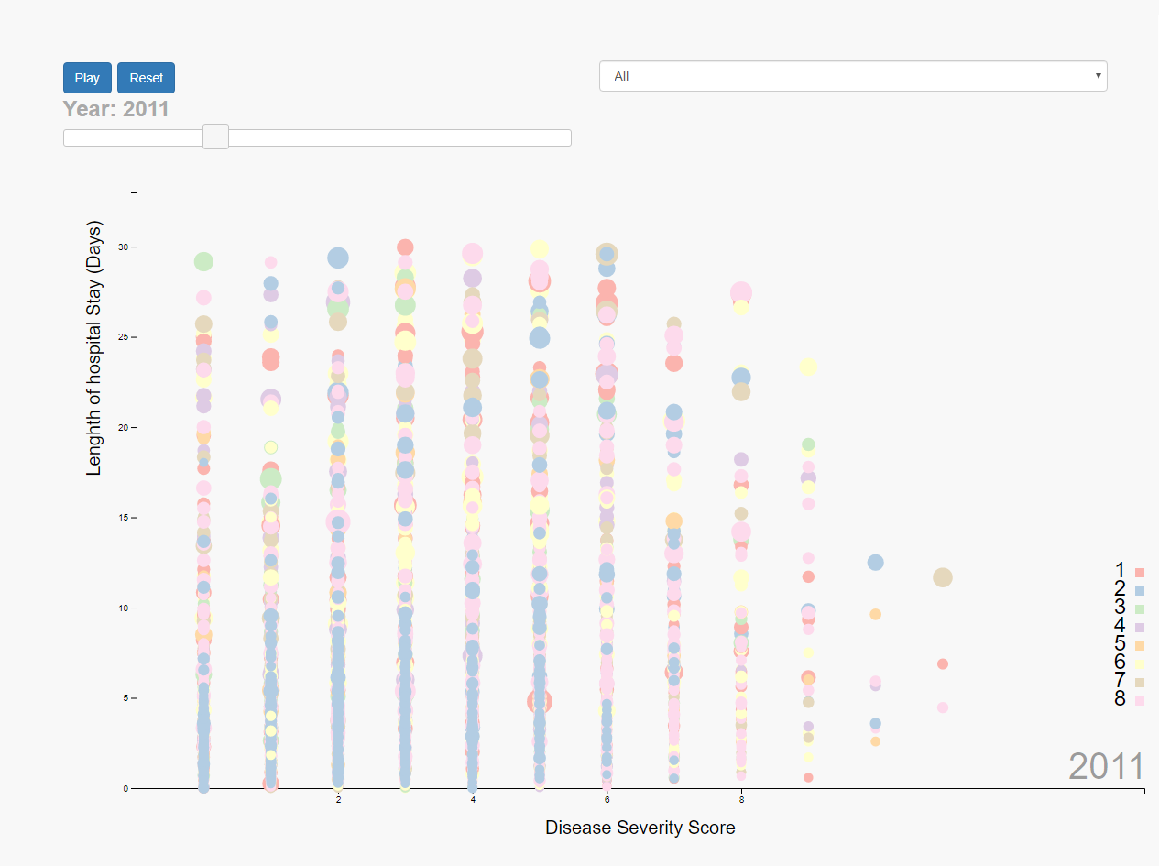
Study of length of stay, cost of care and ward with respect to morbidity

Slide 11
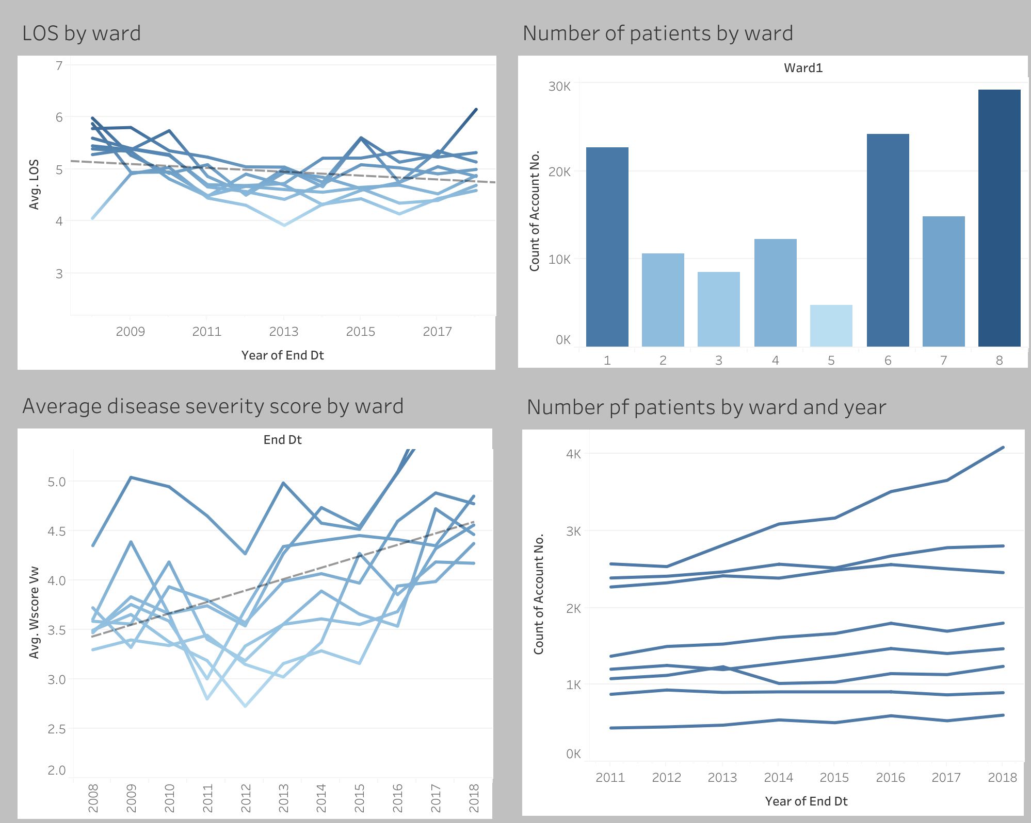

Slide 12
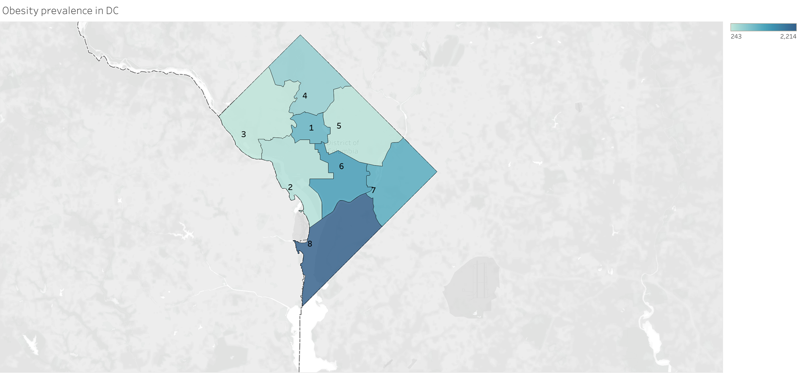
Obesity is highest at wards with highest morbidity

Slide 13
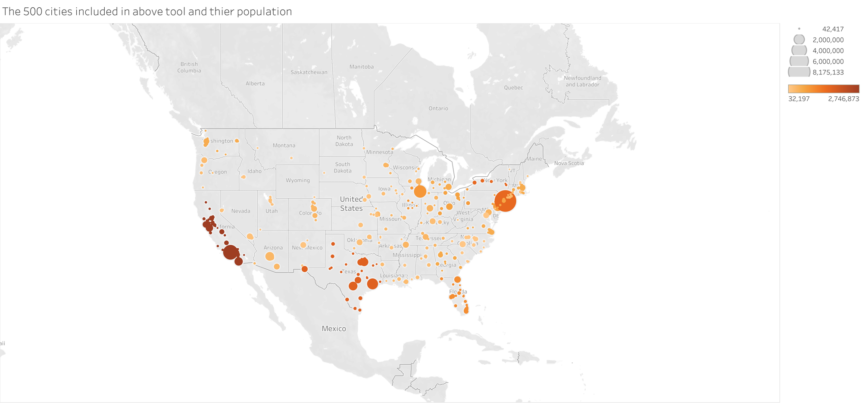
500 cities included in contrasting with DC

Slide 14
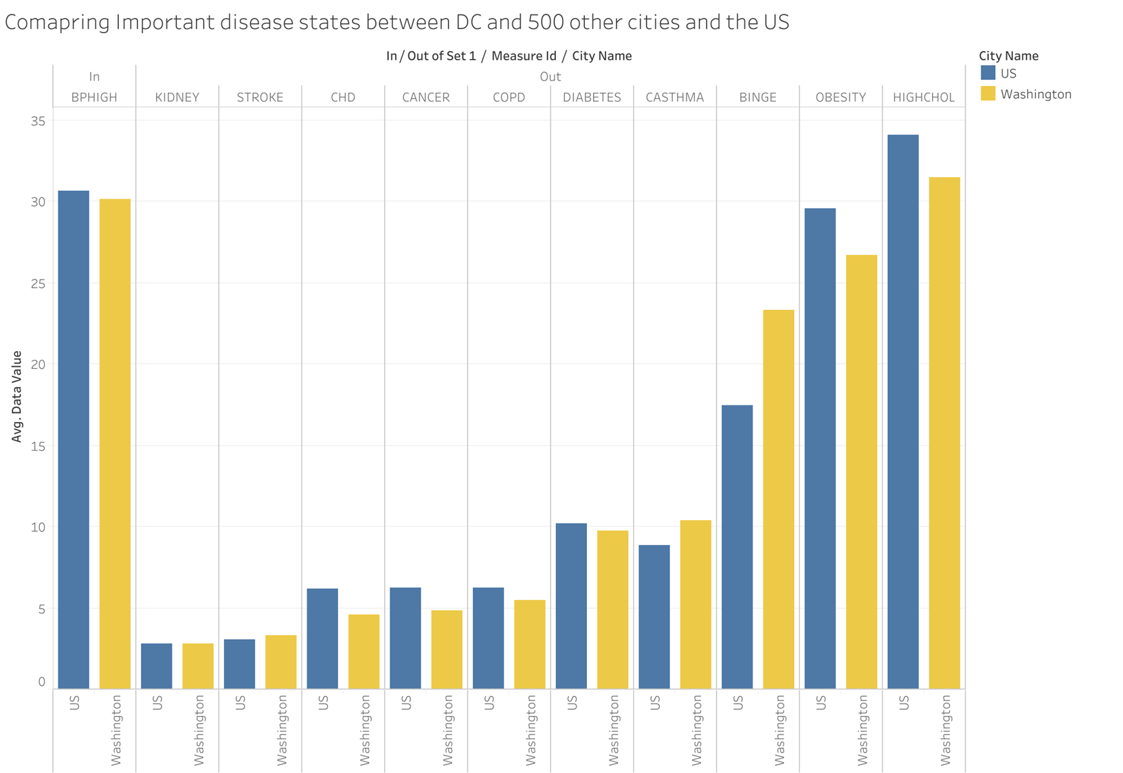
Different condition prevalence in US cities and DC

